Slide 1
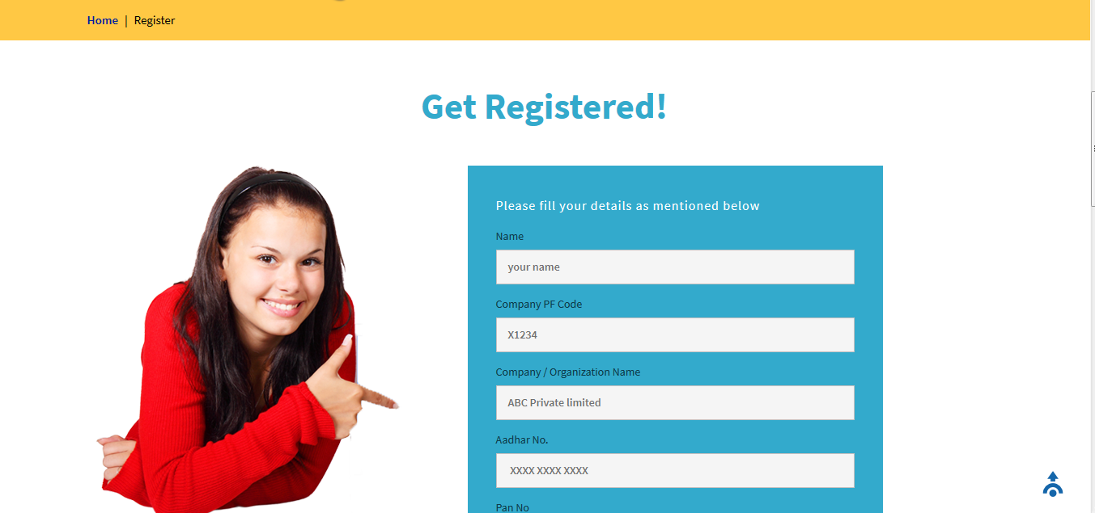
ECR DEMO

Slide 2


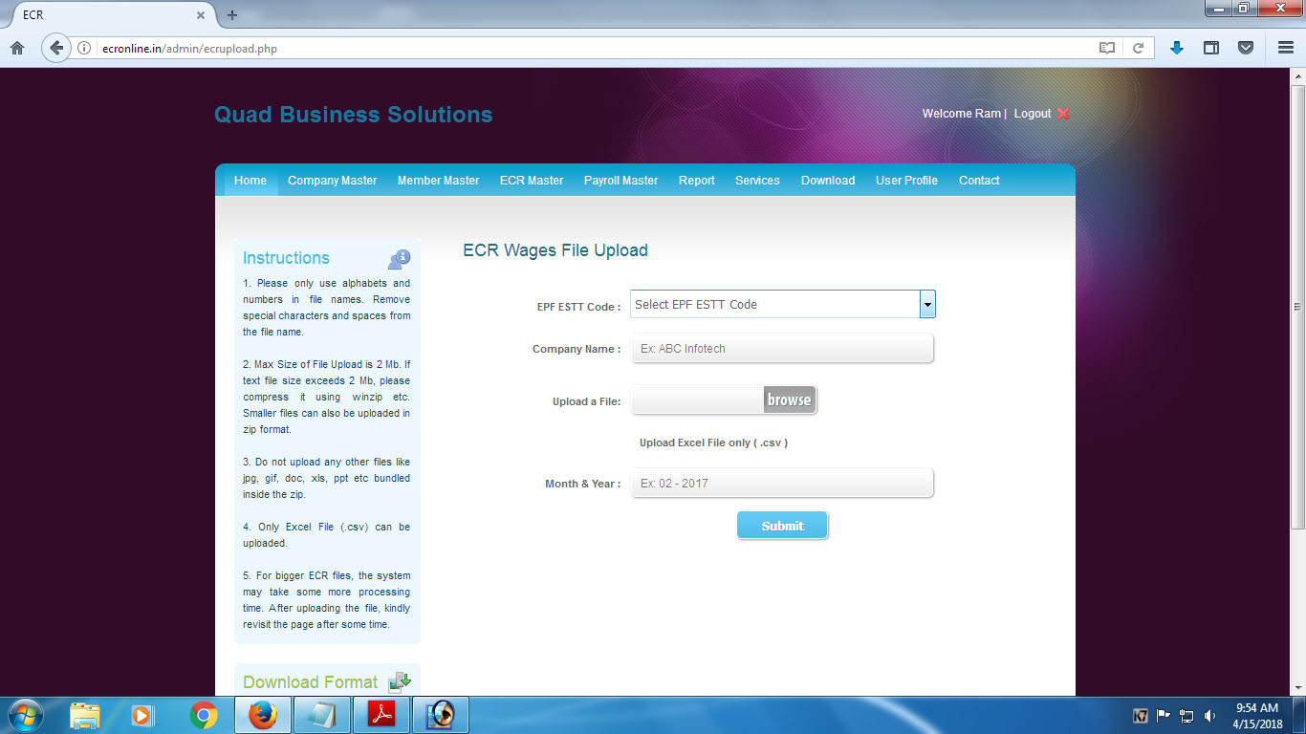

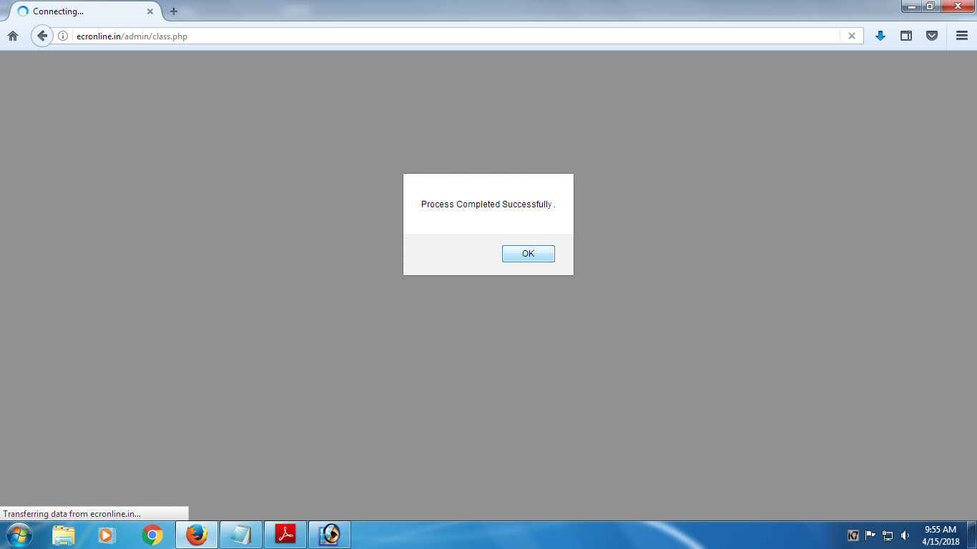

Slide 7
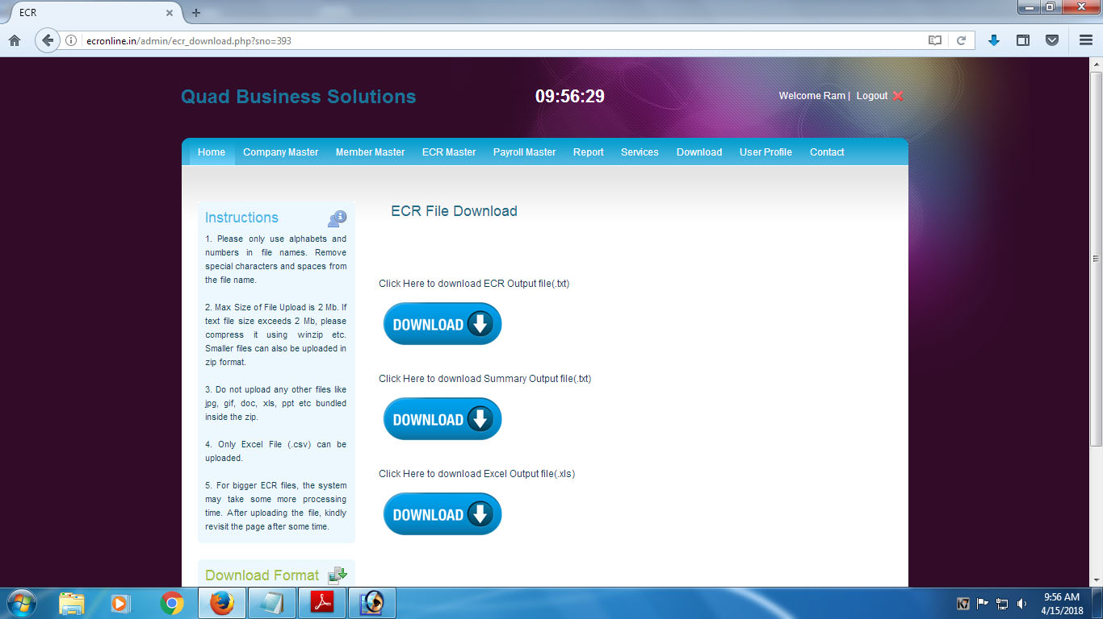

Slide 8
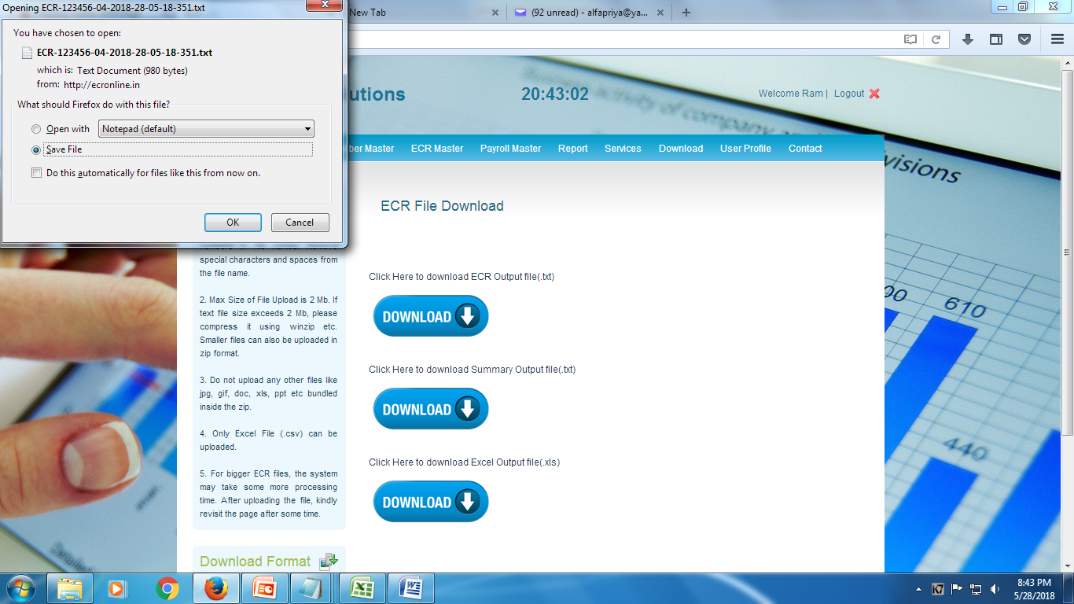

Slide 9


Slide 10
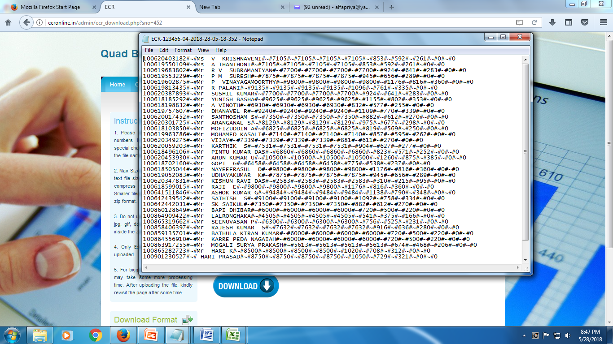

Slide 11
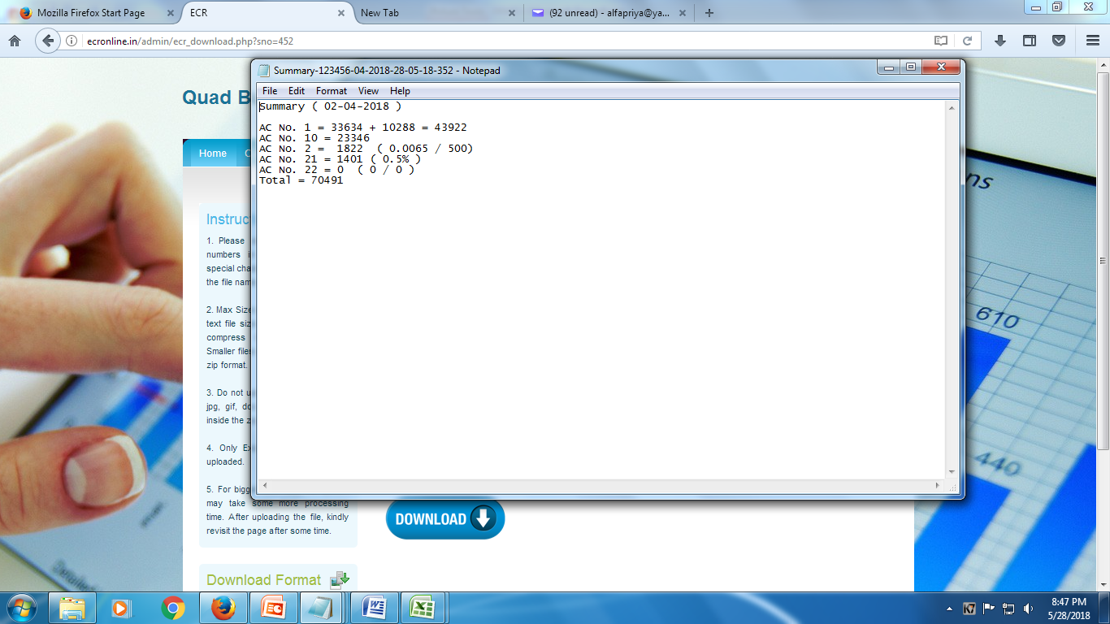

Slide 12
INPUT GIVEN-ONLY CSV
XLS (csv) (6 COLUMN) UAN+PFNO+NAME+TOT WAGE+PF WAGE+NCP
OUTPUT
ECR.TXT
….. as per epfo format to upload unified portal
SUMMARY.TXT
…..Challan summary
ECR+SUMMARY.EXEL
…..internal filing purpose

Slide 13
